Slide 1



SIMPLELANG COMPILER
By Parth Chavda
reallygreatsite.com

Slide 2

INTRODUCTION
SimpleLang is a tiny high-level language designed to run on an 8-bit CPU.
The compiler I built takes a SimpleLang program and processes it through a complete pipeline—lexing, parsing, semantic checking, and finally generating code for the target CPU.
The aim of the project is to show how a real compiler works internally, but in a simplified and easy-to-understand form.
01

Slide 3
ARCHITECTURE
Lexer – Breaks the input into meaningful tokens.
Parser – Builds a structured parse tree using recursive-descent parsing.
Semantic Analyzer – Validates the meaning of the program using a symbol table and scopes.
Code Generator – Produces assembly-like instructions for the custom 8-bit CPU.
02

Slide 4
LEXER
The lexer scans the input character-by-character and groups it into meaningful tokens such as:
Keywords: int, if
Identifiers: variable names
Numbers: integer literals
Symbols: =, +, -,>, {, },(,),<=,>=,<,!=,==
It also ignores whitespace and validates token patterns.
03

Slide 5
PARSER
The parser uses a recursive-descent approach to match tokens against grammar rules.
Core grammar elements:
Declarations
Assignments
Expressions
Conditions (if)
Blocks { … }
The parser builds an Abstract Syntax Tree (AST) reflecting the structure of the program.
04

Slide 6
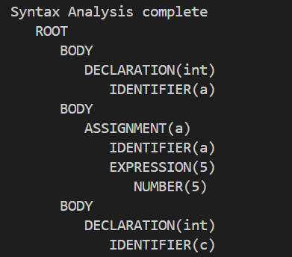
SAMPLE PARSE TREE
STRUCT PARSERNODE{
NODETYPE TYPE;
TOKEN TOKEN;
PARSERNODE **CHILDREN;
INT CHILD_COUNT;
INT CHILD_CAPACITY;
};
05

Slide 7
SEMANTIC ANALYSIS
Maintains a symbol table for variables.
Supports nested scopes (e.g., inside if blocks).
Validates:
Duplicate declarations
Undeclared variables
Type mismatch in expressions
Invalid conditions
06

Slide 8
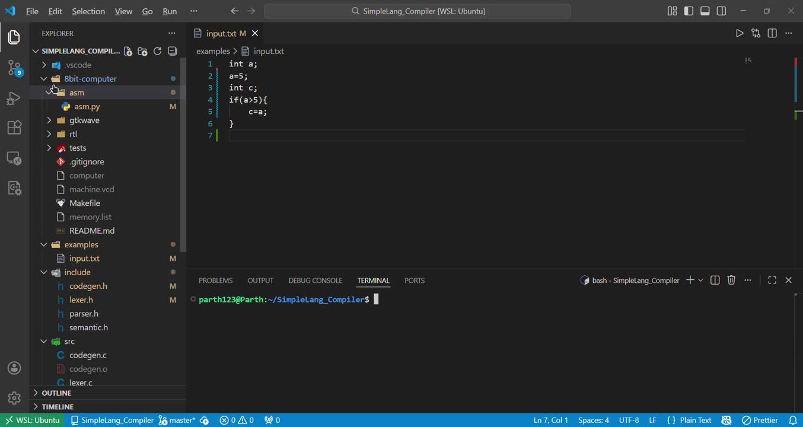
DEMONSTRATION
07

Slide 9
LIMITATIONS
Limited data types (int and bool)
No loops (while, for)
No functions or parameters
No operator precedence beyond basic rule
08

Slide 10
CONCLUSION
The project successfully demonstrates a working compiler pipeline, covering tokenization, parsing, semantic analysis, and code generation for a simple programming language.
09

Slide 11
THANK YOU
10

